Slide 1
Python Introduction / Review
Summer 2021
Notes:
1
1
Check distro statement before using:
DISTRIBUTION STATEMENT A. Approved for pubic release: distribution is unlimited.
This material is based upon work supported under Air Force Contract No. FA8721-05-C-0002 and/or FA8702-15-D-0001. Any opinions, findings, conclusions or recommendations expressed in this material are those of the author(s) and do not necessarily reflect the views of the U.S. Air Force.
© 2021 Massachusetts Institute of Technology.
Delivered to the U.S. Government with Unlimited Rights, as defined in DFARS Part 252.227-7013 or 7014 (Feb 2014). Notwithstanding any copyright notice, U.S. Government rights in this work are defined by DFARS 252.227-7013 or DFARS 252.227-7014 as detailed above. Use of this work other than as specifically authorized by the U.S. Government may violate any copyrights that exist in this work.

Slide 2
Data Structures & Object-Oriented Programming in Python
Things you might not yet have covered
Notes:
1
1

Slide 3
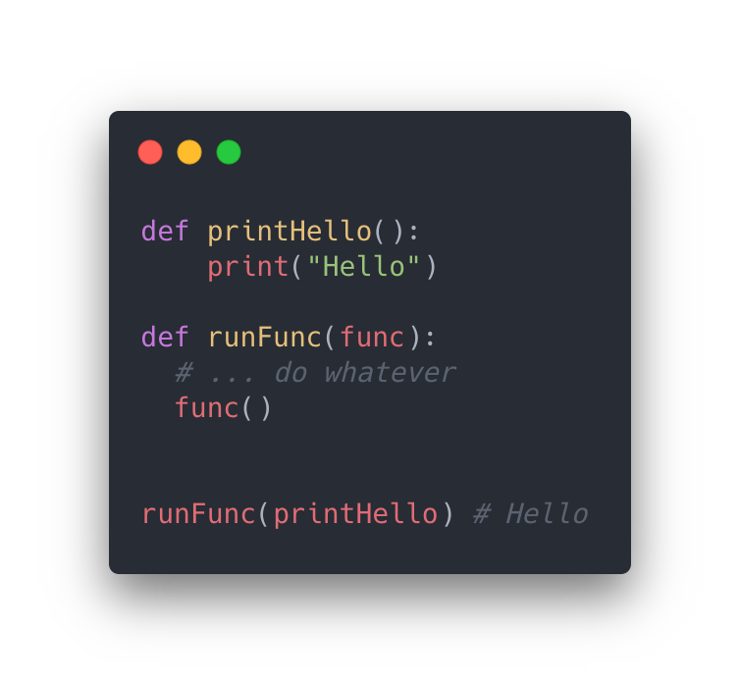
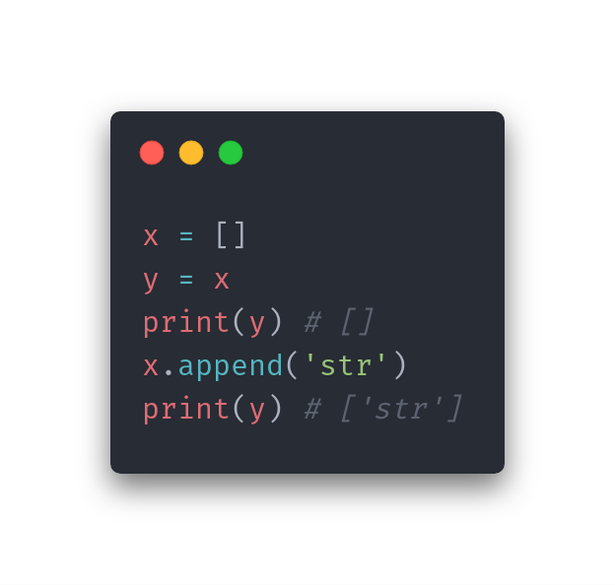
What are Objects?
An Object is a way to group data.
We could use a Person object, which contains an age, name, and address.
In the case of Python, things like Arrays are all Objects. An array contains multiple pieces of data, grouped under one variable.
Everything in Python is an Object, even functions.
You can create your own objects (by using the class keyword)
Many objects are provided to you by default, like Integer or String
Python passes variables by reference
Equals in Python assigns the reference from the right side to the variable on the left side.
The actual object in memory is just “referred to” by the variable.
We can pass any function object to runFunc, and it will execute what’s been passed in.
x and y are variables that both point to the same object.

Slide 4
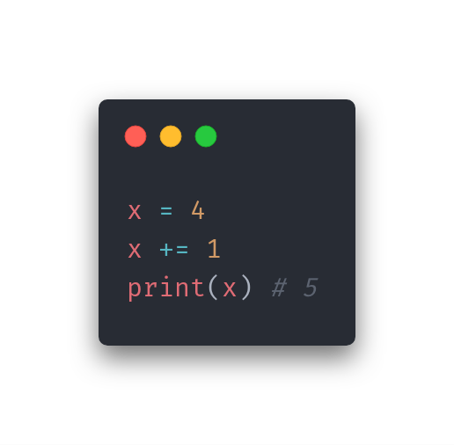
Immutable Types in Python
In general, objects can be mutable or immutable:
Mutable means the object can be modified
Immutable means the object cannot be modified
In Python, all objects are immutable.
Integer (2)
Float (2.00)
String (“hello”)
Boolean (True)
When you use operations such as +=, it creates a new object and assigns it to the variable.
When we add 1, it actually creates a new Integer and assigns it to x.

Slide 5
Ordered Data Structures

Slide 6
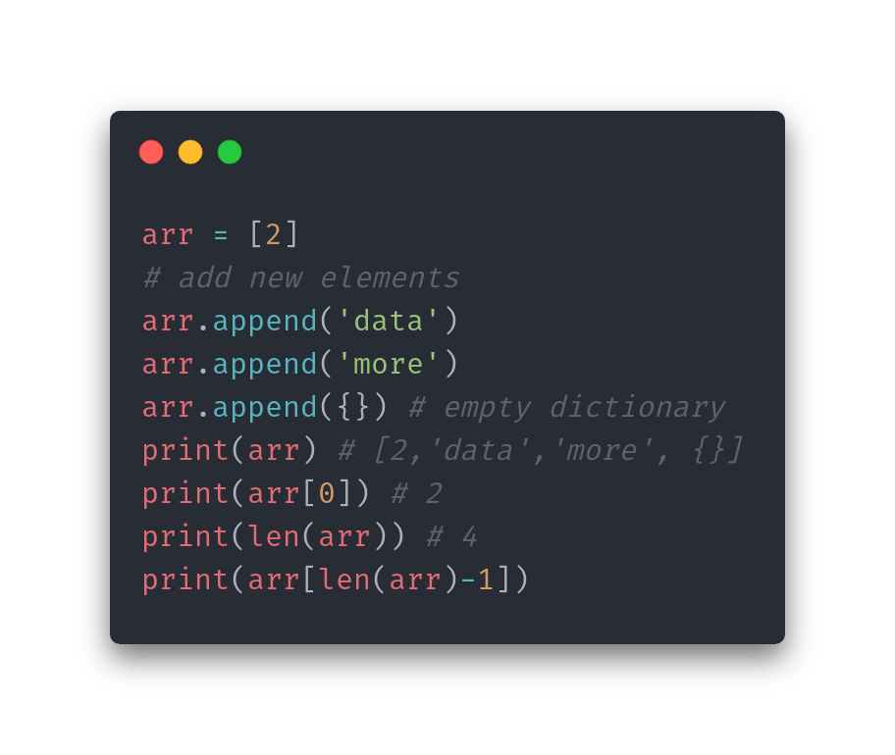
Arrays
Python refers to them as a List
Read, modify, or remove any element
In Python, arrays can be mixed types
Use square bracket notation: [ ]

Slide 7
Structures that can be implemented with Arrays
Stack
Last-in, First-out
Think of it like a stack of papers on your desk. You can only add papers (elements) to the top (index 0), and only take off from the top (index 0).
Queue
First-in, First-out
Think of a line at store checkout. You can enter at the back (last index) and when you reach the front, you exit (index 0).
Multi-Dimensional Array
Arrays inside of arrays
The depth defines the number of dimensions, e.g. an array with arrays of integers as elements is considered 2-dimensional.

Slide 8
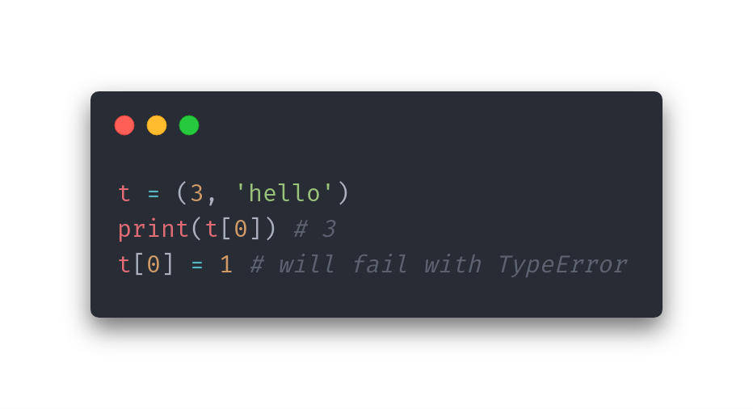
Tuples
An immutable list of elements in Python.
Can’t write any new objects or replace existing, nor can you change the tuple size once it’s been created.
Just like lists, tuples can be mixed types.
Use parenthesis notation: ( )

Slide 9
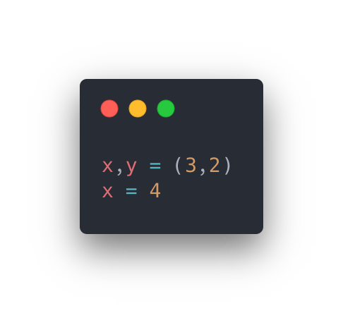
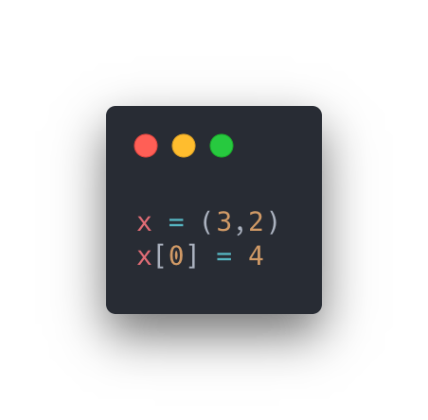
Knowledge Check
a
b
Which of these code blocks will run without error?

Slide 10
Knowledge Check
a
b
a is correct.
The first line of code is known as “packing/boxing”, which makes the tuple into two variables. Then, the variable x is set equal to 4, which is valid. In b, we’re attempting to modify a tuple that x points at, and tuples are immutable.

Slide 11
Unordered Data Structures

Slide 12
Hashing
Objects in Python tend to implement hash codes.
Basic rules about hash codes:
If two objects are considered “equal”, their hash codes must be the same.
It should try to minimize duplicate output values (collisions)
It should be fast to compute
It should be an integer
This hash code will represent the index of the object in memory.
Hash codes allow for two new data structures – sets and hash tables (or “dictionaries”).

Slide 13
What does hashing allow us to do?
Consider the following example:
You want to know if an array contains the string “apple”.
In order to find “apple”, you would need to check every element in the array until you find the word “apple”. Best case, the first element you check is “apple”. Worst case, it’s the last one.
In the worst case, we would need to look at every element in the array. For extremely large arrays, this is computationally intensive and not ideal.
What if we used a hash code?
Assume: ”apple” = 1, “orange” = 5, “pear” = 8.
What if the hash code of the string is the index?
With this, we could have an array of many, many strings. To check if the array contains “apple”, all we have to check is index 1!

Slide 14
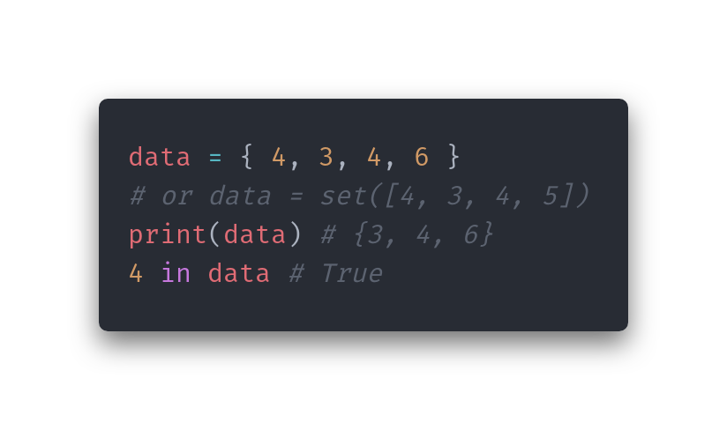
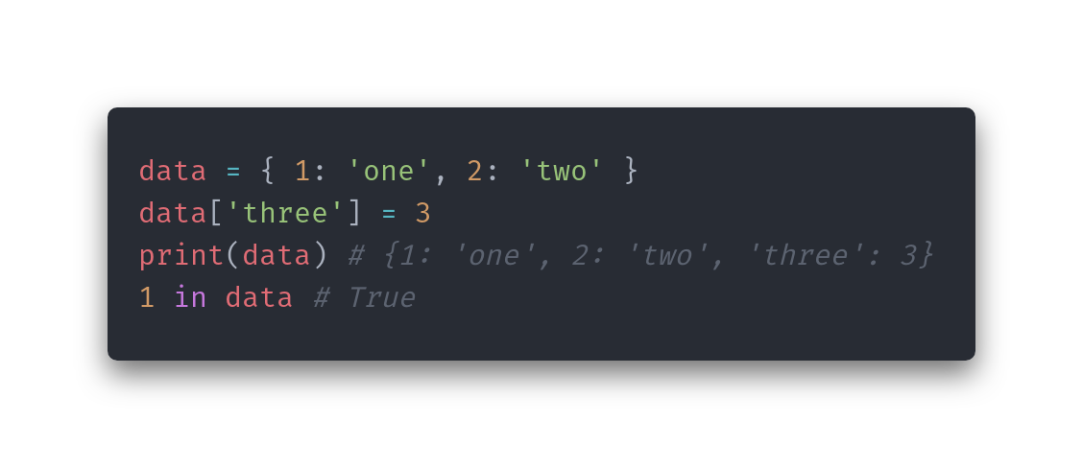
Data Structures
Set
Values must be hashable.
Values with same hash override each other.
Use curly bracket notation: { }
Dictionary
Keys must be hashable.
Keys with same hash override each other.
Uses key/value pairs.
Use curly bracket notation, with colon to denote a pair: { key: value }

Slide 15
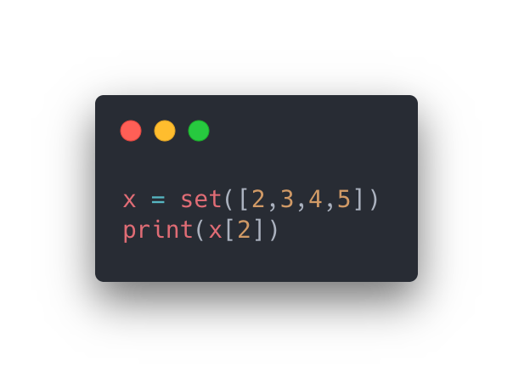
Knowledge Check
What will happen when we run the above code?

Slide 16
Knowledge Check
Python will throw the following:
TypeError: 'set' object is not subscriptable
Recall that sets are unordered. There is no “index 2”.

Slide 17
Object-Oriented Programming

Slide 18
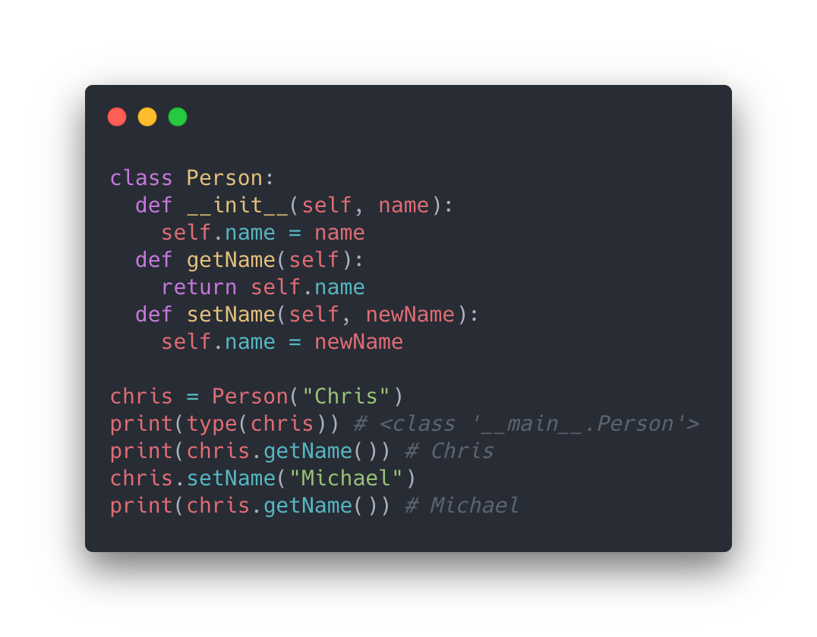
Classes vs. Objects
Classes:
Represent a “type” of an object. Acts as a template.
Lets you define the instance variables and member functions that an object of that type has access to.
self is passed by Python into each member function. This refers to the Object itself.
Objects:
Are individual instances of a class.

Slide 19
Classes vs. Objects
In the example to the right:
Person is a class
chris represents an Object of type Person.
__init__() is a function called any time a new Person is created. This applies for all classes.
getName() is a getter, which returns the requested variable without changing anything.
setName() is a setter, which returns nothing but changes the instance variable, self.name.

Slide 20
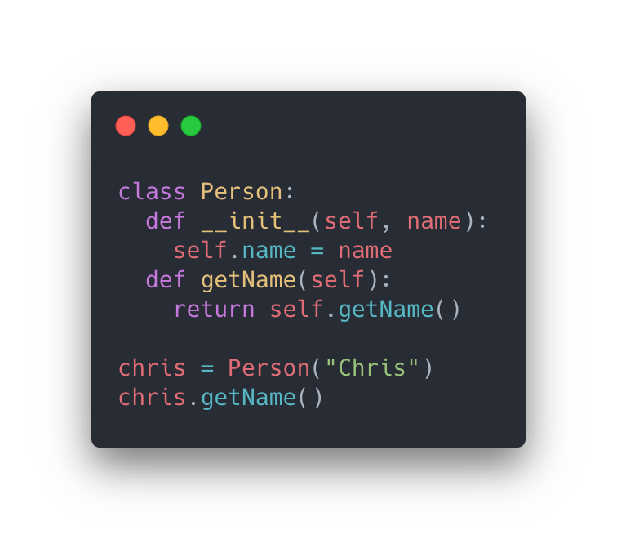
Knowledge Check
What will happen when we run the above code?

Slide 21
Knowledge Check
Because getName() is a member function, being called on itself (self), this code will enter an infinite loop.

Slide 22
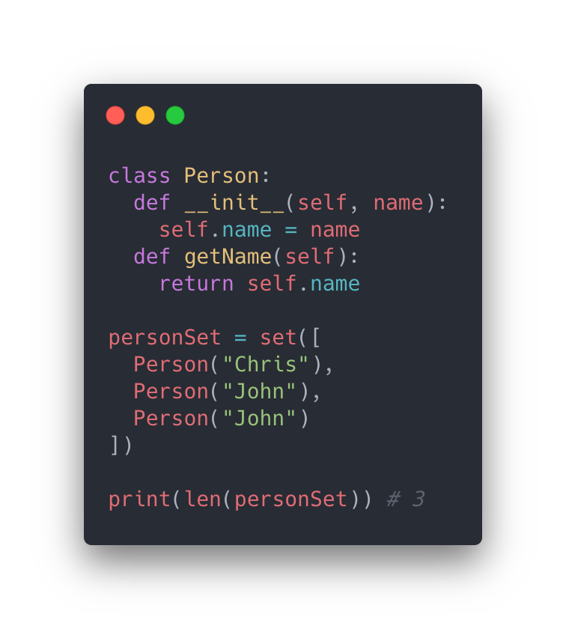
Remember Hashing?
If sets do not allow duplicates, why is personSet length 3?

Slide 23
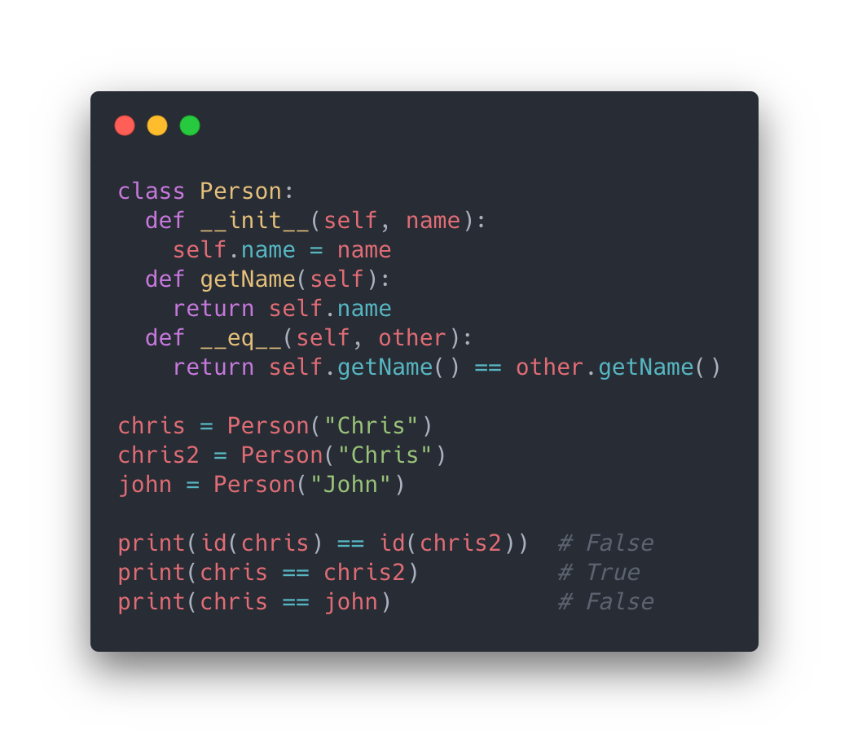
Equality
Custom classes, by default, use the id() command to generate a hash code.
id(obj) returns the memory address of obj.
No objects are ever at the same memory address at the same time.
Let’s address equality first. What makes two Person objects equal?
Use __eq__(self, other) to define what makes two Person objects equal.
In this case, we compare the names.

Slide 24
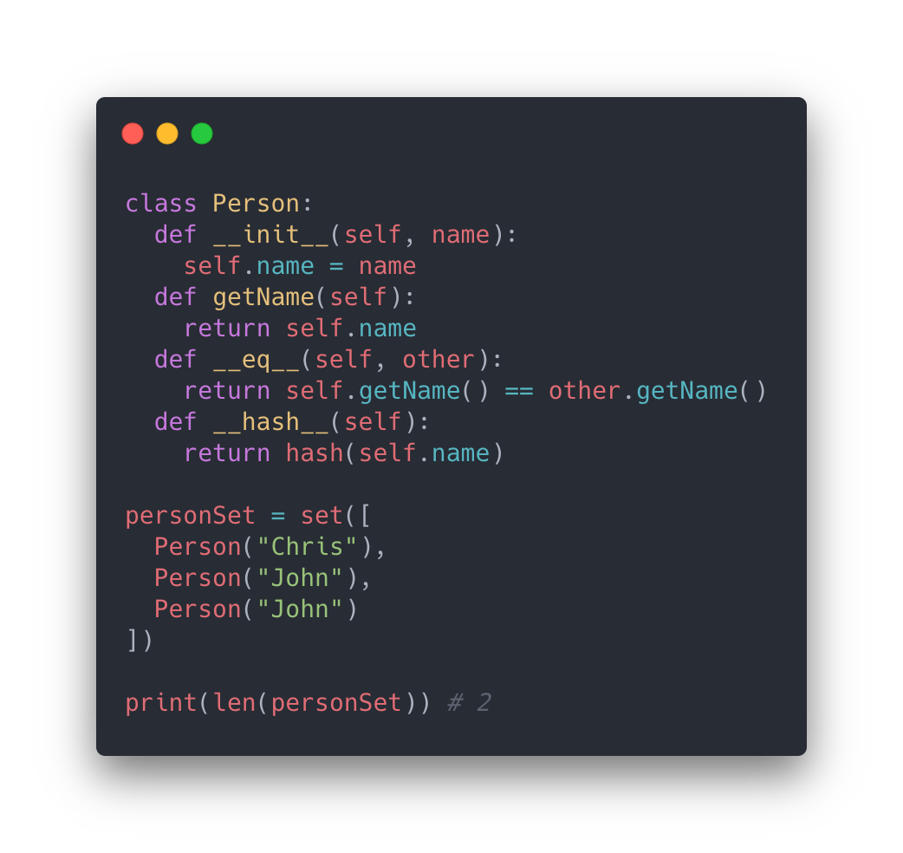
Hashing
However, this will not work for hashing just yet.
Because Python sees an __eq__ function, it stops using id() because there is clearly the potential for equality of objects.
It would throw an error instead.
So, we need both an __eq__() and a __hash__() function.
Writing a good hash function is hard. But, we know Python’s hash function for Strings works well. So, we just use that on our only instance variable.
Our code works as expected now!

Slide 25
Inheritance

Slide 26
Inheritance Introduction
Assume we have a “Pet” class
Has instance variables such as a “name”, “age”, and more.
If our Pet is a cat, we want access to a meow() function.
That function doesn’t make much sense if the Pet is a snake.
So, we use inheritance.
We can create a Cat class that extends from Pet, and a Snake class that also extends from Pet!
These classes both share all the functions and variables that a Pet would normally have, but allows this new class to add new functionality based on the type.

Slide 27
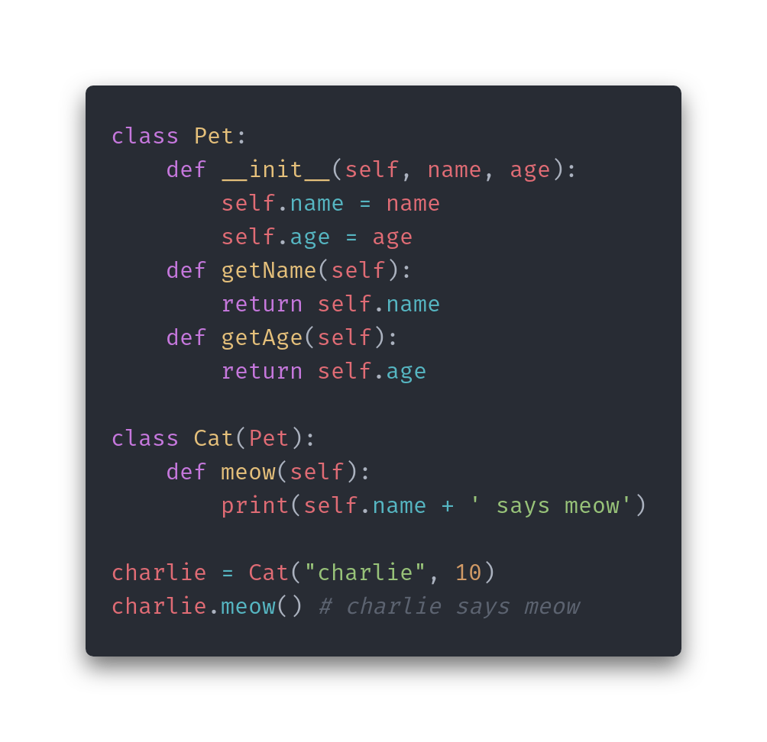
Inheritance in Python
In Python, this is achieved during construction of the class.
In this example, Cat extends off of Pet.
We use the parenthesis notation to ”pass in” the class that Cat is extending from.
By default, Cat is now using Pet’s initializer.
This lets Cat have access to all of Pet’s functions and instance variables, while adding it’s own functions.

Slide 28
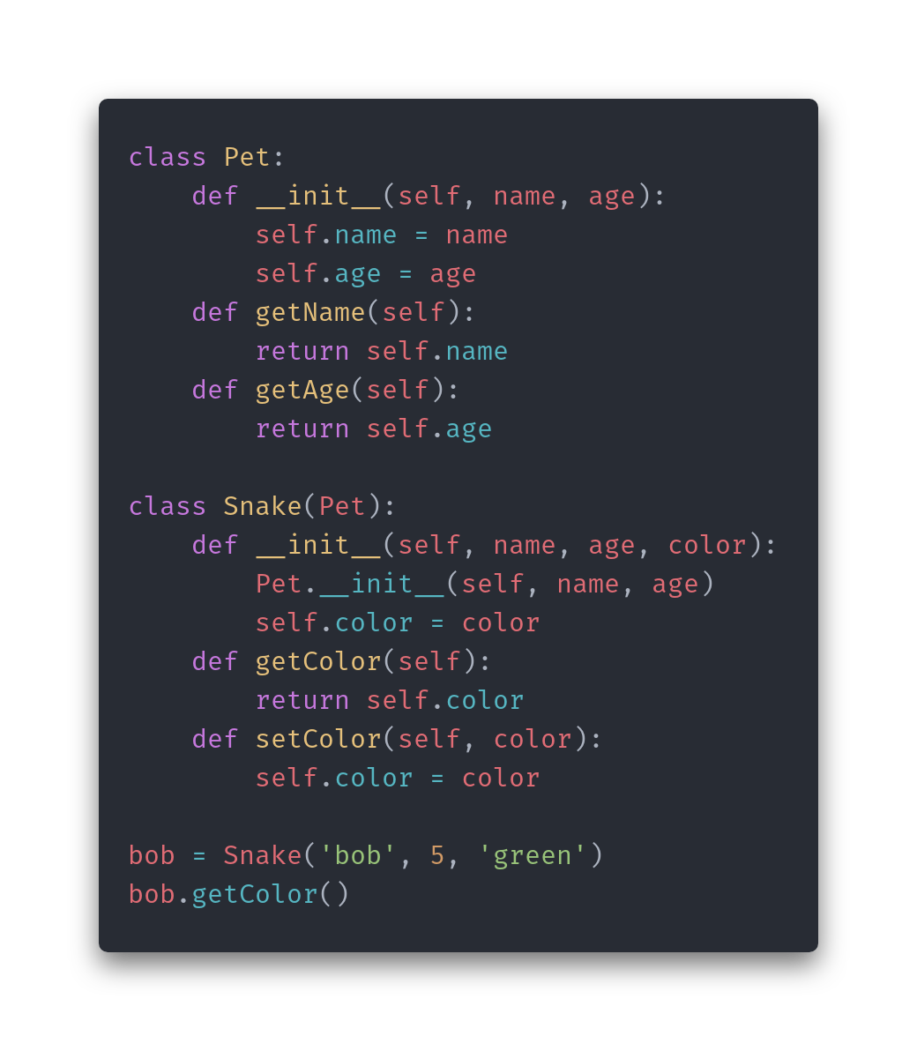
Additional Instance Variables
What if we want additional variables initialized for the Snake class?
We can define a new __init__ function.
Replaces Pet’s init.
Requires that you call the parent’s __init__ to ensure everything is initialized properly.
We get access to all of Pet’s methods and instance variables.
But, we also get access to new variables and methods that we define in Snake.

Slide 29
When to use inheritance
Inheritance may be necessary when there is a “is-a” relationship. If a Snake is a Pet, then it makes sense that Snake extends Pet.

Slide 30
Enumerations (Enums)

Slide 31
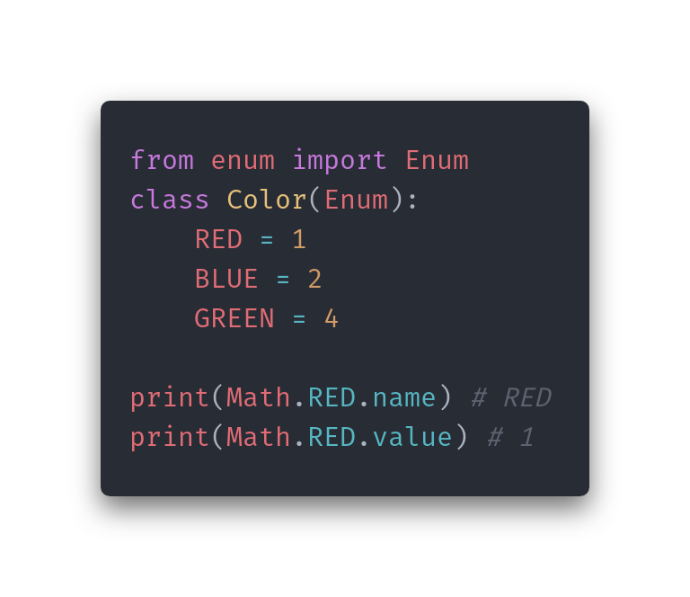
Enums
An enumeration is a set of names bound to unique, common values.
Enums hide a value under a more descriptive title.
Exposes constant values.
You can access both the name and value of an object defined off an enumeration.
In Python, this is implemented as a class.
Other languages have it as an actual type beyond classes.

Slide 32
Wrap-Up
Overview
Objects
Immutable Types
Data Structures
Ordered Data Structures
Arrays
Stack
Queue
Multi-Dimensional Array
Unordered Data Structures
Hashing
Sets
Dictionaries
Object-Oriented Programming
Classes
Member functions
Instance variables
Equality
Hashing
Inheritance
Enums
Names
Values

Slide 33




